Slide 1
SPAM SMS DETECTION
MOBILE APPLICATION
Students
Berkcan ÇELİK
Muazzez AYPEK
Sarper SİNANOĞLU
Emre GEDİKOĞLU
Advisor
Assistant Prof. Dr. Instructor Roya CHOUPANI
Co-Advisor
Dr. Instructor Faris Serdar TAŞEL

Slide 2
CONTENTS
The Widespread Use of Text (SMS) Messaging
What is SMS Spam?
Why Spam SMS Detection is Necessary
Previous Similar Work
Objective
Model & Methodologies
Technologies
What Happens After Spam Detection?
User Interface Sketch
Conclusion

Slide 3
THE WIDESPREAD USE OF TEXT (SMS) MESSAGING
Billions of mobile phone users send trillions of text messages daily.
The annual worldwide SMS traffic had risen to over 6.8 trillion all over the world at the end of 2010.
Although the use of real-time messaging applications has a tendency to surpass the preference of SMS usage nowadays, communication via SMS is still widely used throughout the world.

Slide 4

WHAT IS SMS SPAM?
Any SMS that is irrelevant with respect to our interests, opposes a threat to us and our well being, or consumes our time can be regarded as a spam SMS.

Slide 5
WHY SPAM SMS DETECTION IS NECESSARY
Spam SMS detection serves as a defense wall against the security and privacy issues of the SMS environment and provides a much more relevant and understandable SMS inbox to mobile phone users.

Slide 6
PREVIOUS SIMILAR WORK
During the course of our literature research, we came upon mobile applications that are designed for the purpose of spam SMS detection. However, they perform filtering and detection just by telephone number or keywords, which are entered manually by the user.

Slide 7

OBJECTIVE
The goal of our project is to detect and filter SMS spam.
By doing so, we will provide a safe, legitimate and clearly comprehendable SMS inbox.

Slide 8
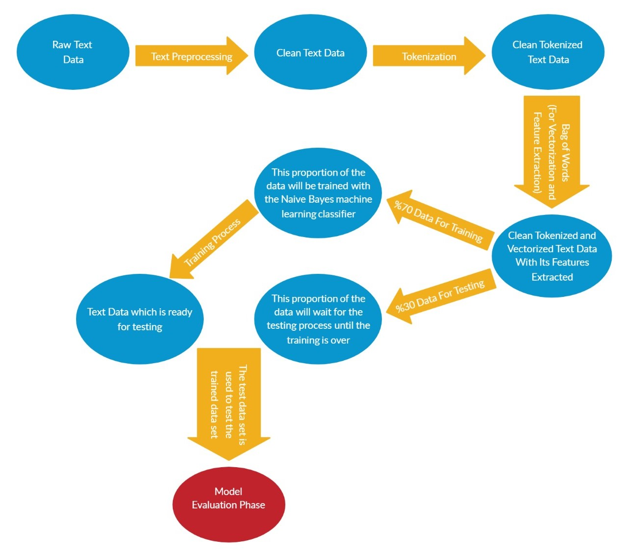
MODEL & METHODOLOGIES

Slide 9



TECHNOLOGIES
We will use many technologies:
Python
React Native
MySQL

Slide 10
WHAT HAPPENS AFTER SPAM DETECTION?

Slide 11
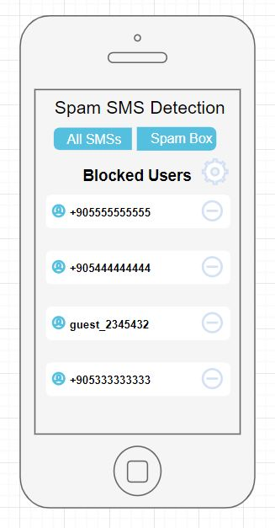
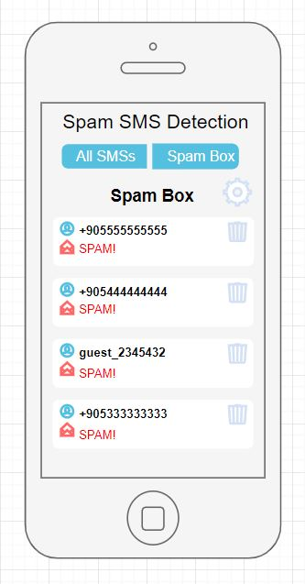
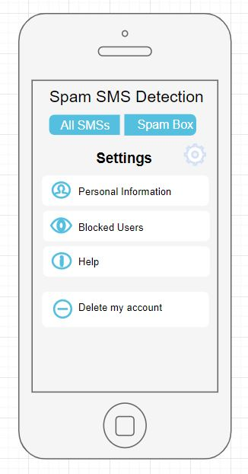
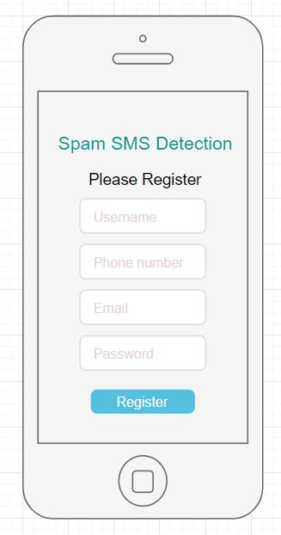
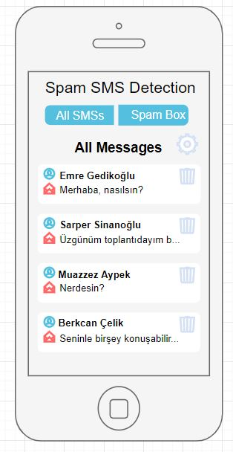
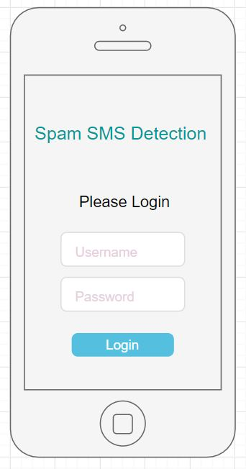
USER INTERFACE SKETCH

Slide 12
CONCLUSION
Spam SMS detection proves to be a significant topic for the telecommunication world in the modern day.
With this project, we aim to efficiently utilize machine learning for the spam detection task.
Our project is still under development...

Slide 13
